Slide 1

Home Automation Systems: Benefits, Technologies, and Future Trends
Transforming the way we live through intelligent technology

Slide 2
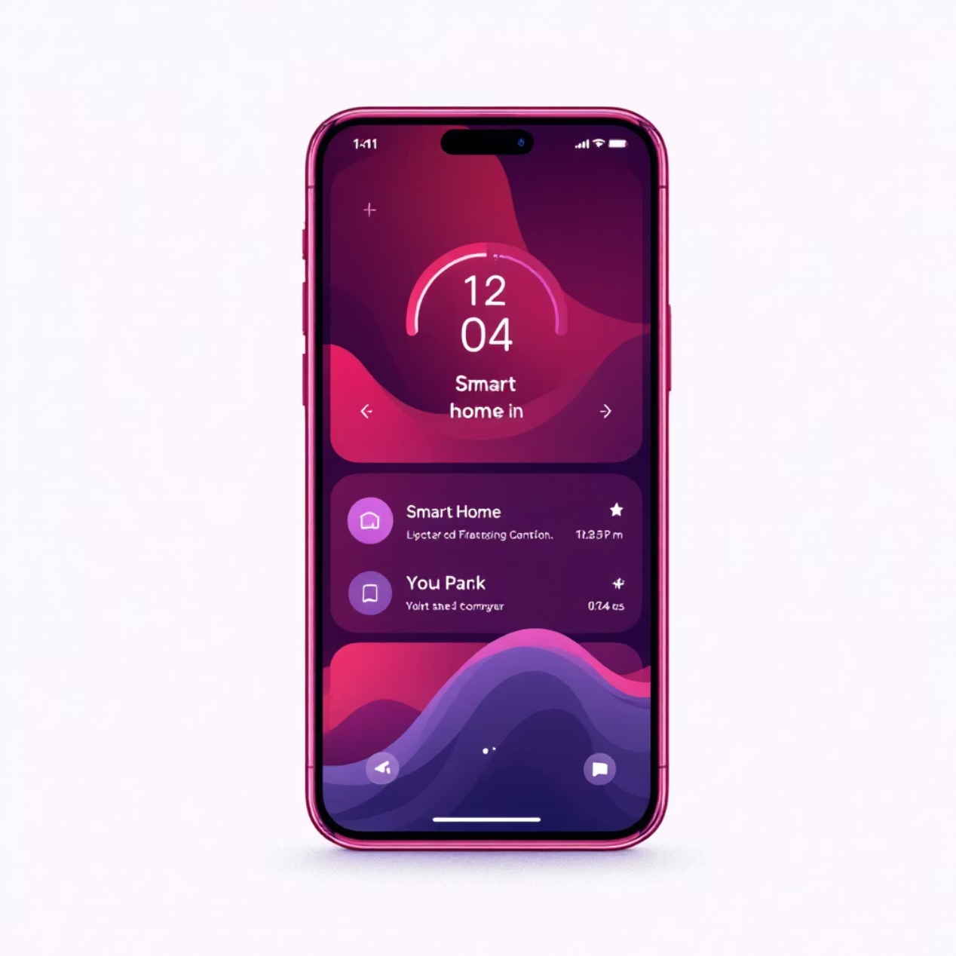
Introduction
Home automation represents a revolutionary shift in how we interact with our living spaces, making daily life more convenient, efficient, and secure. By seamlessly integrating smart technology into our homes, we can automate routine tasks, reduce energy consumption, and enhance safety measures.
This comprehensive study explores the fundamental principles of home automation, examining how interconnected devices work together to create intelligent living environments. We'll delve into the core technologies that power these systems and analyze the tangible benefits they bring to homeowners.
From simple lighting controls to sophisticated security networks, home automation is reshaping our relationship with technology and redefining what it means to live in a truly smart home.

Slide 3





What is Home Automation?
Home automation enables the automatic control of household devices and systems, creating an interconnected ecosystem that responds to user preferences and environmental conditions.
Sensors
Microcontroller
Detect motion, temperature, light levels, and other environmental factors
Processes sensor data and executes automated commands
Devices
Mobile App
Lights, locks, thermostats respond to controller signals
User interface for monitoring and controlling the entire system

Slide 4
Example Use Cases
Home automation transforms everyday devices into intelligent systems that anticipate and respond to your needs automatically.
Smart Lighting
Climate Control
Automatically turn lights on/off based on motion detection or preset schedules
Intelligent thermostat adjusts temperature automatically for comfort and efficiency
Motion-activated hallway lights
Learning daily routines
Sunset/sunrise scheduling
Remote temperature control
Dimming for movie nights
Energy usage optimization
Security Systems
Access Control
Advanced cameras detect motion and send instant alerts to your mobile device
Smart door locks provide secure remote access via mobile applications
Keyless entry systems
Real-time notifications
Temporary access codes
Video recording triggers
Entry/exit logging
Facial recognition features

Slide 5
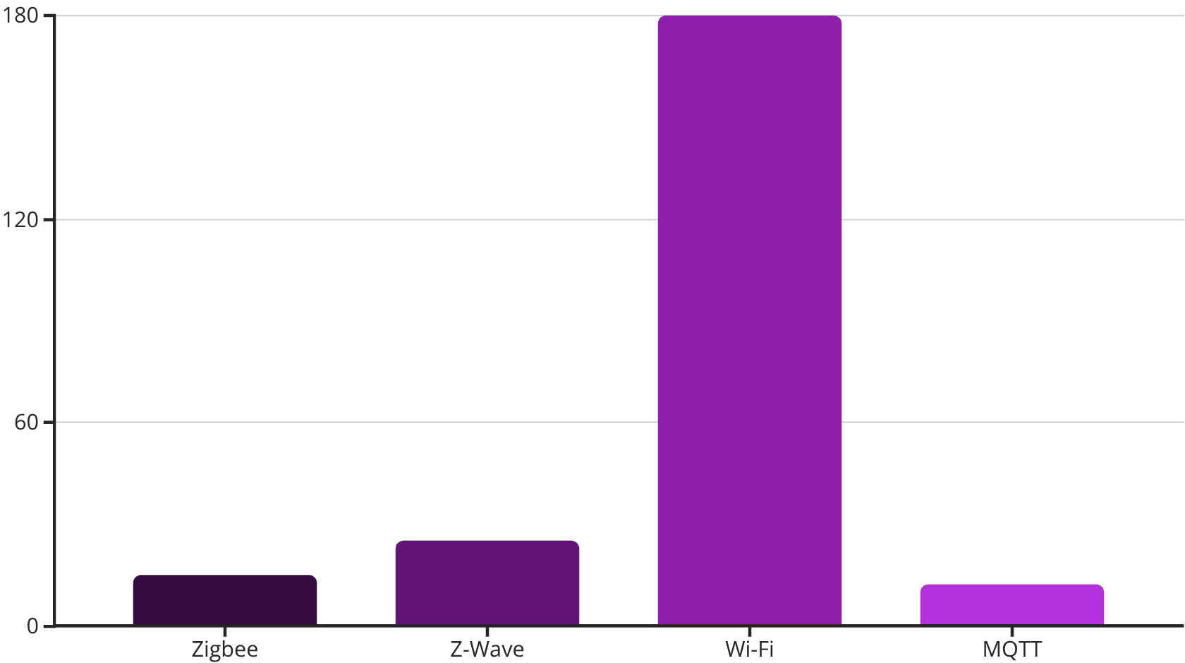
Technologies Used
Core Hardware Components
Arduino Microcontrollers
Open-source platform ideal for DIY automation projects and custom sensor integration
Raspberry Pi Systems
Powerful mini-computers capable of running complex automation software and multiple protocols
Power consumption comparison shows why low-energy protocols like Zigbee and MQTT are preferred for battery-powered sensors and devices.
Communication Protocols
Zigbee: Low-power mesh networking for battery devices
Z-Wave: Reliable home automation standard with excellent range
Wi-Fi: High-bandwidth connection for data-intensive devices
MQTT: Lightweight messaging protocol for IoT communication

Slide 6




Automation Platforms
Modern home automation platforms serve as the central hub, coordinating communication between diverse smart devices and providing unified control interfaces.
Home Assistant
Open-source platform offering extensive customization and local control. Supports thousands of devices including sensors, thermostats, and custom integrations. Perfect for tech-savvy users who want complete control over their automation setup.
Google Home
Voice-activated ecosystem with seamless integration across Google services. Excels at controlling smart speakers, lighting systems, and entertainment devices through natural language commands and smartphone apps.
Amazon Alexa
Comprehensive smart home platform with extensive third-party support. Manages smart plugs, security cameras, and thousands of compatible devices through voice commands and the Alexa mobile application.

Slide 7




Benefits of Home Automation
Home automation delivers transformative advantages that enhance daily living while providing long-term value through improved efficiency and security.
Ultimate Convenience
Energy Optimization
Control all devices remotely via smartphone apps or voice commands, eliminating the need to manually adjust settings throughout your home.
Intelligent power management automatically reduces consumption by turning off unused devices and optimizing heating/cooling schedules.
Enhanced Safety
Improved Accessibility
Real-time security alerts, automatic door locking, and emergency notifications provide comprehensive protection for your family and property.
Voice controls and automated systems make home management significantly easier for elderly residents and individuals with mobility challenges.

Slide 8
Challenges and Solutions
While home automation offers tremendous benefits, several challenges can impact adoption. Understanding these obstacles and their practical solutions helps ensure successful implementation.
High Initial Costs
Privacy and Security Concerns
Challenge: Complete smart home systems can require significant upfront investment
Challenge: Connected devices may expose personal data to potential security breaches
Solution: Start with basic devices like smart plugs and bulbs, then gradually expand your system as budget allows. Focus on high-impact areas first.
Solution: Implement edge computing solutions that process data locally, use strong passwords, and regularly update device firmware.
Complex Setup Procedures
Device Compatibility Issues
Challenge: Technical configuration can overwhelm non-technical users
Challenge: Different manufacturers use incompatible protocols and standards
Solution: Choose user-friendly platforms like Home Assistant with guided setup wizards, or start with plug-and-play devices from major manufacturers.
Solution: Select platforms with broad device support like Google Home or Amazon Alexa, or choose devices that support universal standards like Matter.

Slide 9


Conclusion
Home automation represents a transformative technology that fundamentally improves how we interact with our living spaces. By automating routine tasks and optimizing energy usage, these systems deliver tangible benefits in convenience, safety, and efficiency that enhance daily life for homeowners.
The accessibility of basic smart devices has made home automation more affordable than ever before. Simple solutions like smart plugs, automated lighting, and voice-controlled assistants provide immediate value while serving as stepping stones toward more comprehensive automation systems.
Looking ahead, the future of home automation promises even greater integration and intelligence. As artificial intelligence, edge computing, and universal compatibility standards mature, we can expect smart homes to become more intuitive, secure, and seamlessly integrated into our daily routines.
Key Takeaway: Start small with affordable devices, focus on high-impact areas, and gradually build your smart home ecosystem as technology continues to evolve and improve.
30%
85%
Energy Savings
User Satisfaction
Average reduction in utility costs
Homeowners report improved quality of life

